Slide 1
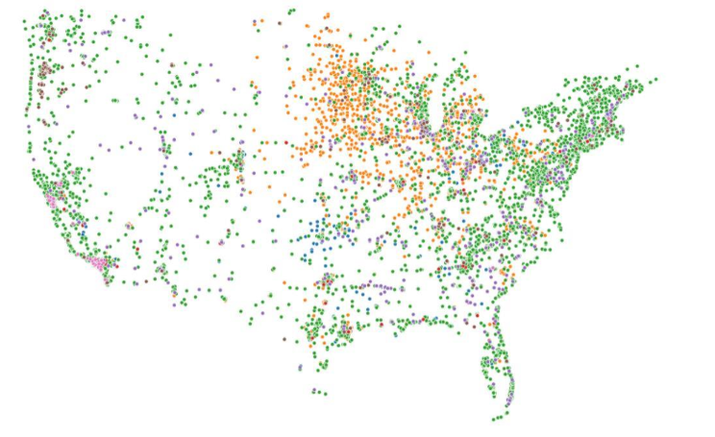
Alternative Fuel Stations Predicting Market Growth
Priya Sathish
Feb 2020

Slide 2
Problem Synopsis
Transport sector uses Petroleum based fuel conventionally
Economic impact
Environmental quality
Fuel cost
Dependency
Energy security
………. driving the necessity for Alternative Fuel sources, its availability and access.

Slide 3
Business Case
Goal:
Predicting growth of Alternative Fuel Stations and Alternative Fuel Powered Vehicles across the United States
Stakeholders:
Industries that produce Alternative Fuels
Automobile industry
Vehicle owners with sustainability mindset
Government agencies
Fuel stations with multiple fuel types

Slide 4

Dataset Acquisition
https://afdc.energy.gov/data_download/

Slide 5
Data Wrangling
Station Features
Station ID
Fuel type code
State
Geocode status
Latitude
Longitude
Open date
Challenges
Missing values
Outliers
Duplicates
Format issues
Vehicle Features
Year
Fuel type
Sales

Slide 6
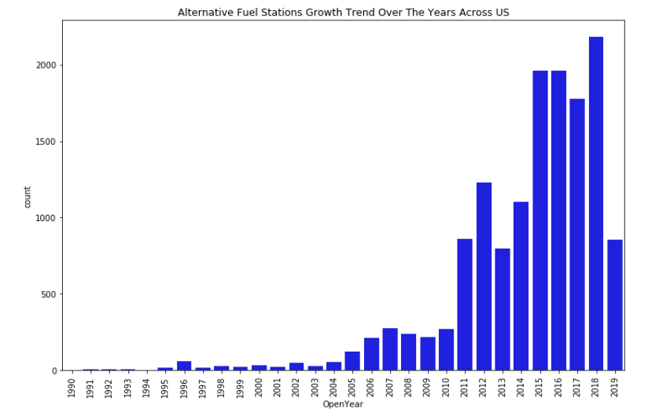
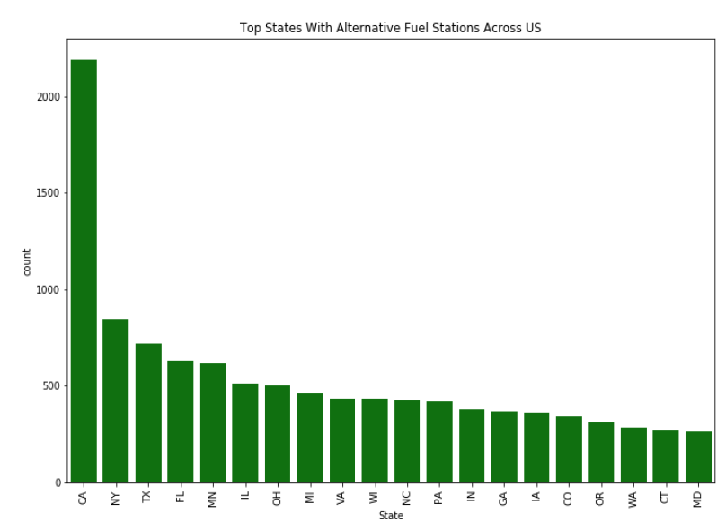
Exploratory Data Analysis
Growth trend of alternative fuel stations across US
Exponential growth since 2011 – awareness created by
Clean Cities Coalitions. https://cleancities.energy.gov/about/
Higher concentration of alternative fuel stations in California is suspected due to Low Carbon Fuel Standard campaign. http://www.cadelivers.org/lowcarbon-fuelstandard/ (http://www.cadelivers.org/low-carbon-fuel-standard/)

Slide 7
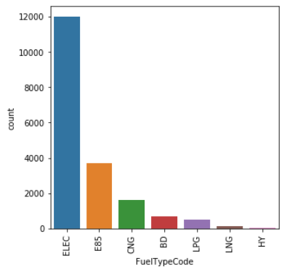
Alternative Fuel Types
Over 90% of alternative fuels are comprised of electricity and ethanol85
Higher number of electric vehicles is attributed to no tail pipe emissions, environmental friendly
Convenient access to public charging stations and no cost
Ethanol85 is 100% renewable fuel manufactured from corn.

Slide 8
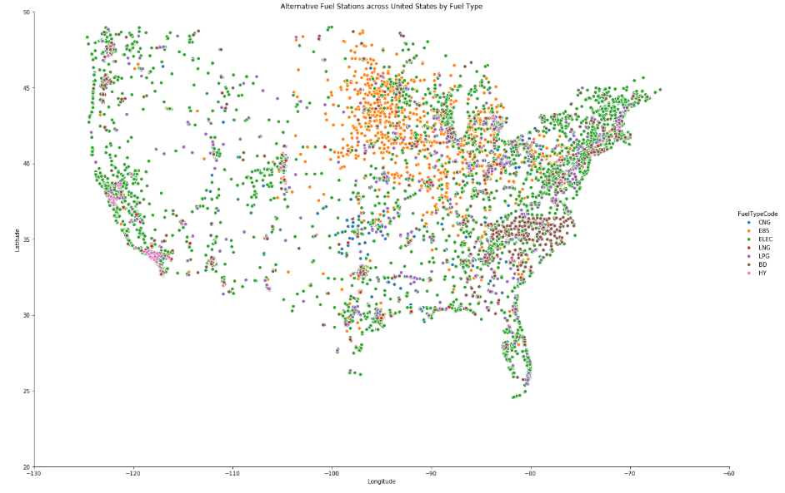
Fuel Stations across US by Fuel Type
Electric fuel stations are prominent along Coast line
Ethanol85 stations are concentrated in Central Plain states due to high corn harvest
Hydrogen stations are densely located in California
Bio diesel stations mostly located in South Eastern states

Slide 9
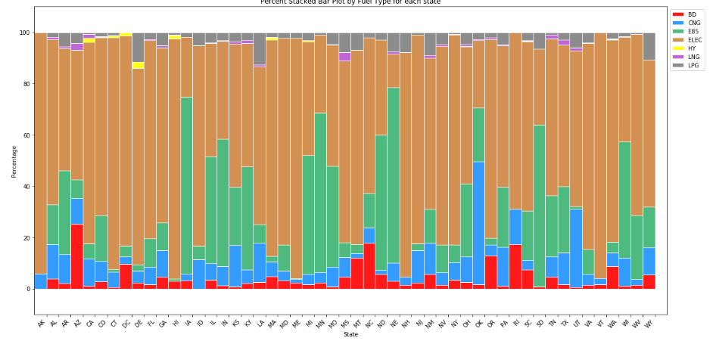
% Distribution by Fuel Type for each State
Electric stations are higher in states except for those states where E85 is available.
E85 is higher in states where corn is harvested.

Slide 10
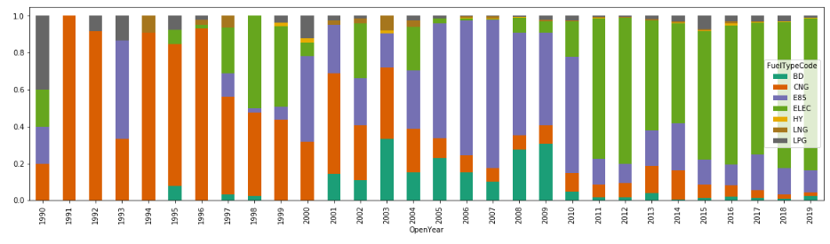
Shift in Fuel Type over years
In 90’s most fuel stations were CNG
In 2000, there was a shift towards BD and E85
Since 2010, there is exponential growth in Electric fuel stations

Slide 11
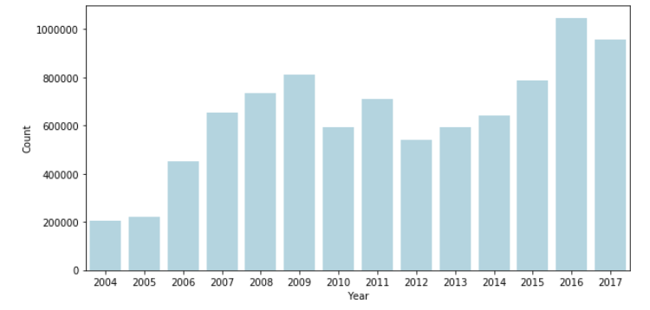
Vehicle Sales by Year
Alternative fuel equipped vehicles
Dip in sales during recession
With strong economy in last few years the growth rate for these vehicles is exponential
This is also driven by environmental factors and User awareness

Slide 12
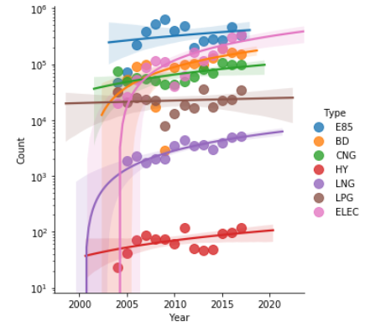
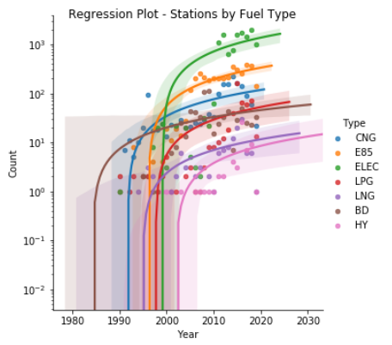
Regression plot – Vehicle Sales by Fuel Type
Regression plot – Stations by Fuel Type

Slide 13
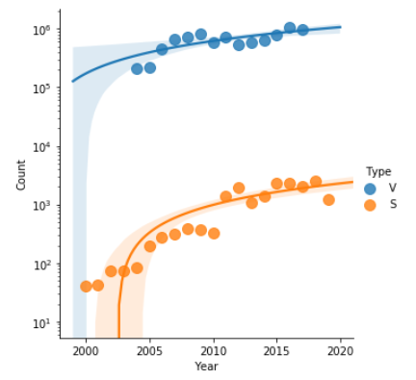
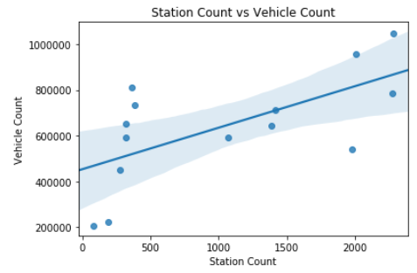
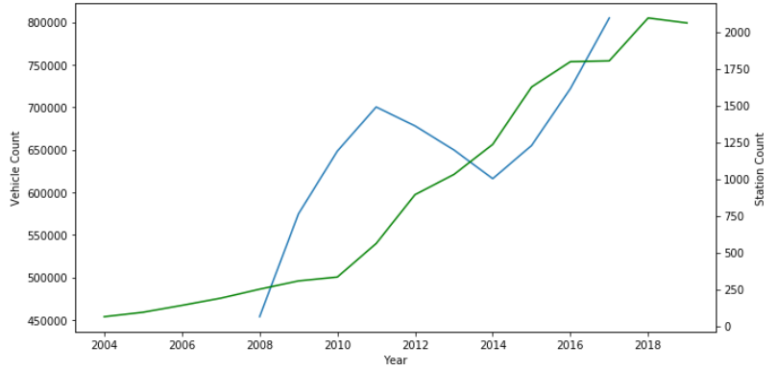
Correlation between Stations and Vehicles
Strong correlation from the year 2005
Pearson co-efficient 64%

Slide 14
EDA Summary
Models and Algorithms that can be implemented with the dataset which could provide value to the stakeholders:
Predict the number of Alternative Fuel Stations
Predict the number of Alternative Fuel Vehicles
Predict best location for the next Alternative Fuel Station
Assess individual fuel cost trend’s effect on the rate of change in the number of Alternative Fuel Stations and vehicles equipped with that fuel type

Slide 15
Models Under Consideration to Predict the growth of Alternative Fuel stations
Model Development
ARIMA - Autoregressive Integrated Moving Average Model (Traditional Forecasting)
– chosen due to the nonstationary property of the data
LSTM - Long Short-Term Memory Network (Deep Learning based Forecasting)
– chosen for its learning capacity by preserving and training the features of given data for a longer period
Goal is to compare the ARIMA and LSTM models with respect to their performance in reducing error rates. (66%Split)
Assessment Metric: Root Mean Squared Error (RMSE) – Measures the differences or residuals between actual and predicted. The main benefit is that it penalizes large errors.
Perform Hyperparameter tuning on the best model.

Slide 16
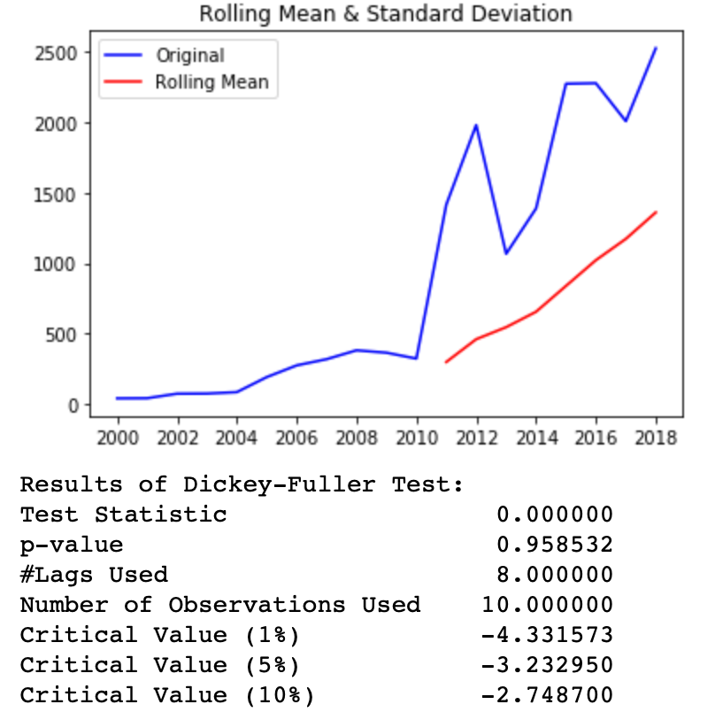
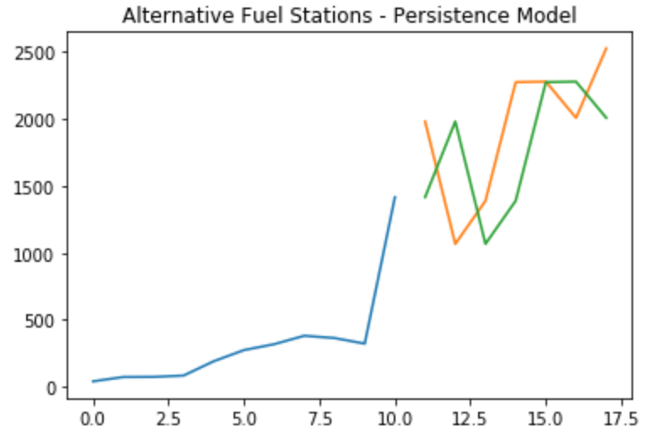
Dickey Fuller Test and Naïve Forecast
Null Hypothesis (H0): If failed to be rejected, it suggests the time series has a unit root, meaning it is non-stationary. It has some time dependent structure.
Alternate Hypothesis (H1): The null hypothesis is rejected; it suggests the time series does not have a unit root, meaning it is stationary. It does not have time-dependent structure.
From the plot of the persistence model predictions it is clear that the model is 1-step behind reality. There is a rising trend and year-to-year noise in the stations count, which highlights the limitations of the persistence technique.

Slide 17
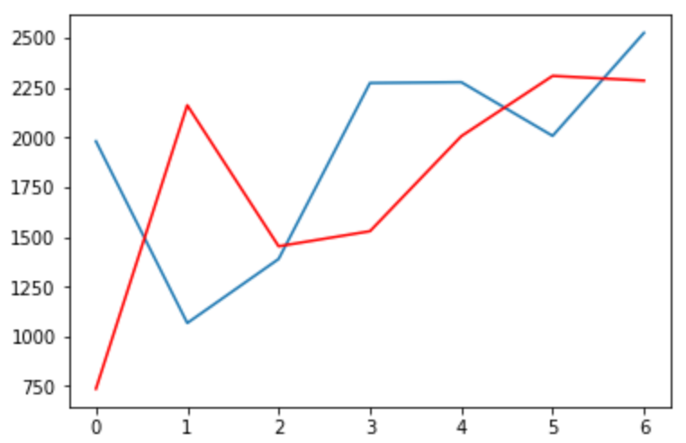
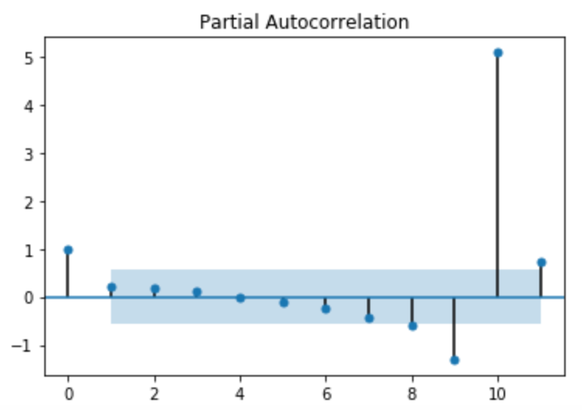
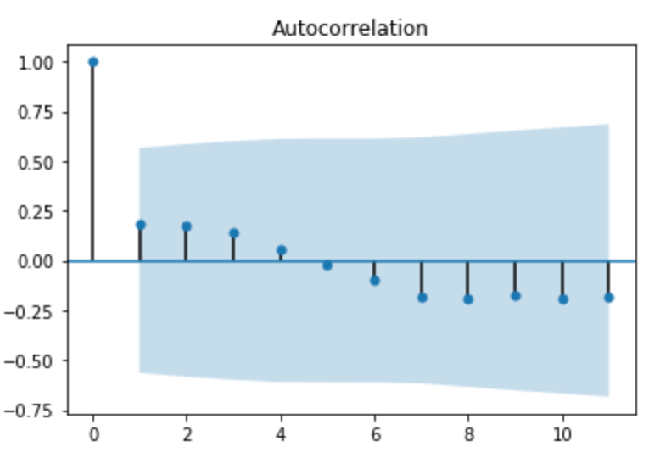
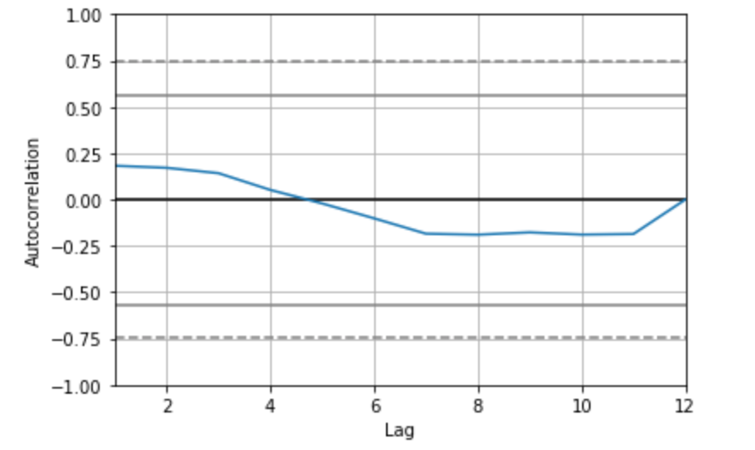
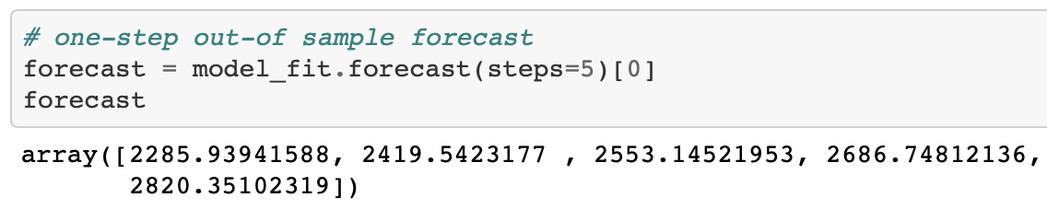
ARIMA
From the plots we determine the parameters p, q, d and fit an ARIMA(0,1,1) model. This sets the lag value to 0 for autoregression, uses a difference order of 1 to make the time series stationary, and uses a moving average model of 1.
A line plot is created showing the expected values (blue) compared to the rolling forecast predictions (red).
Test RMSE: 710.1796

Slide 18
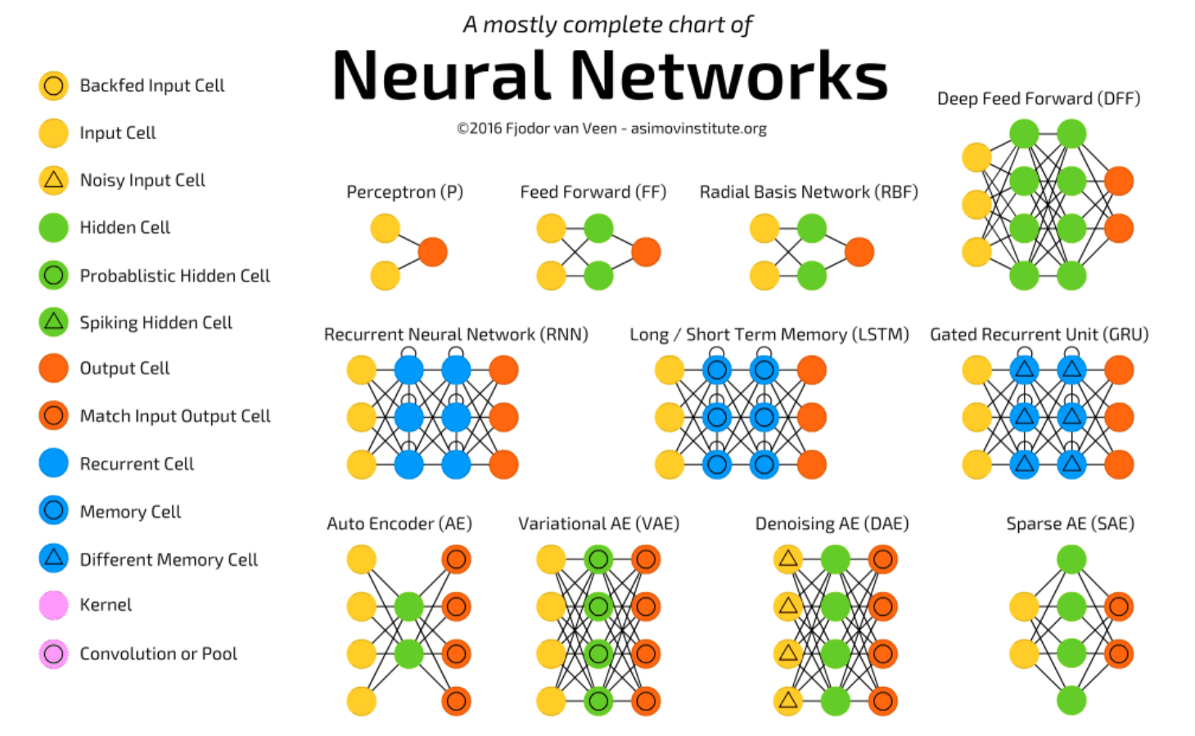
Glimpse of Neural Network Why LSTM?

Slide 19
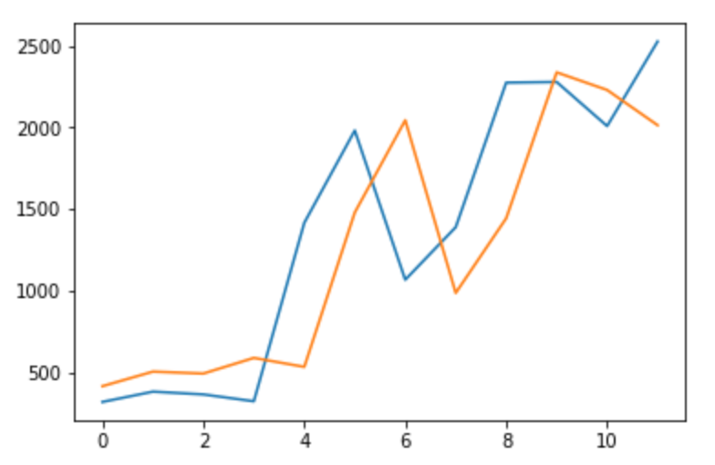
LSTM
Transform the time series into a supervised learning problem
Transform the time series data so that it is stationary.
Transform the observations to have a specific scale.
Develop LSTM model
A line plot is created showing the expected values (blue) compared to the rolling forecast predictions (orange).
Test RMSE: 521.25
Average reduction in Error Rates obtained by LSTM is 27% compared to ARIMA indicating the superiority of LSTM over ARIMA.

Slide 20
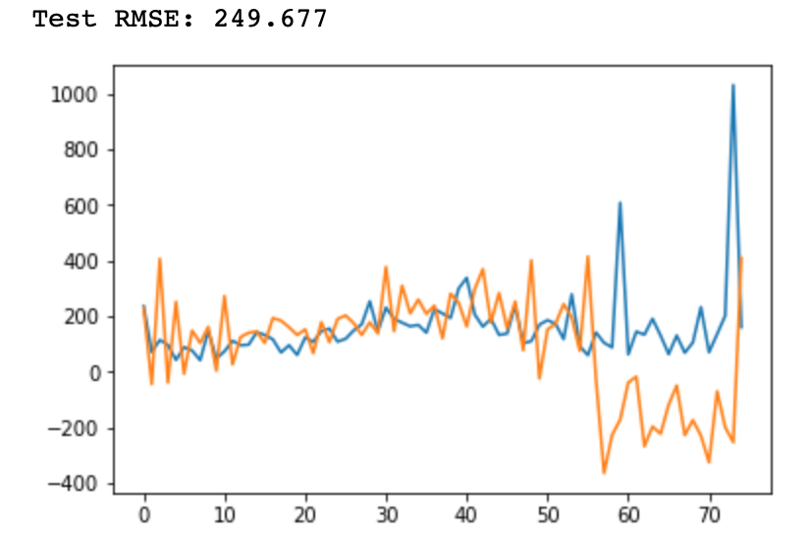
LSTM Model
Consider Monthly data
Model Evaluation: A rolling-forecast scenario will be used, also called walk-forward model validation. The root mean squared error (RMSE) will be used as it punishes large errors and results in a score that is in the same units as the forecast data, namely monthly growth in the number of Alternative Fuel Stations.
Drawbacks: A difficulty with neural networks is that they give different results with different starting conditions.
Approach: Develop a robust model repeating the experiment multiple times, then take the average RMSE as an indication of how well the configuration would be expected to perform on unseen data on average. This is often called multiple repeats or multiple restarts.

Slide 21
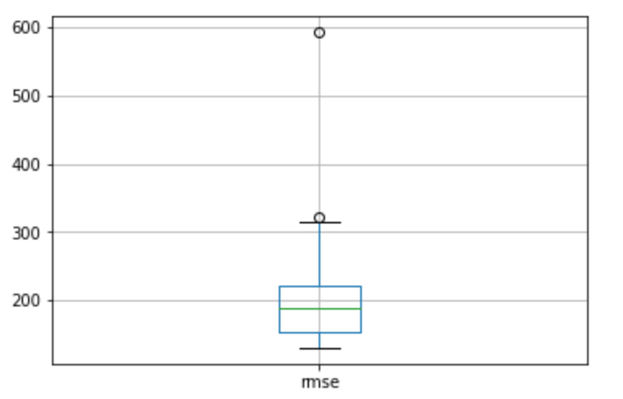
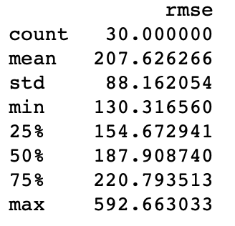
LSTM Robust Model
We will use 30 repeats as that would be adequate to provide a good distribution of RMSE scores.
Next Step: Tune the Hyperparameters and explore different configurations.

Slide 22
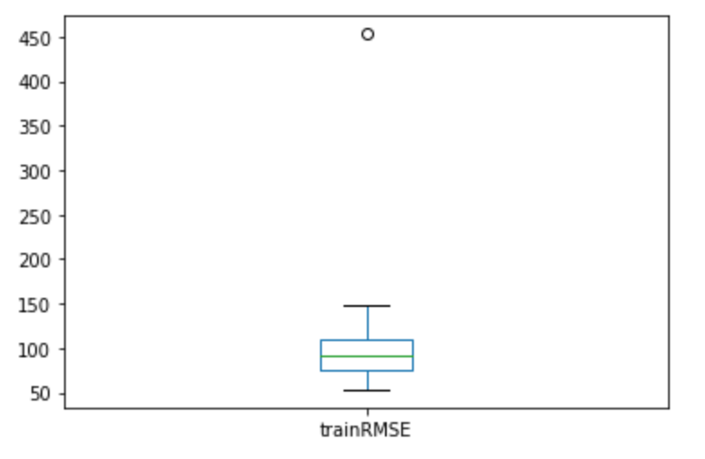
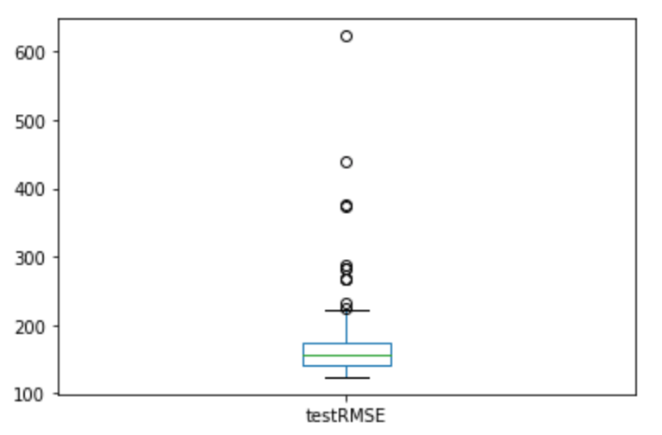
LSTM Hyperparameter Tuning
Overall Range of train RMSE
No good theory on how to configure a neural network.
Systematic approach to explore different configurations. (Range of Neurons - 1 .. 5, Range of Epochs - 2^0 ..2^12)
Perform experimental runs for each scenario. (10 Runs)
Next Step: Tune and interpret the results for number of training epochs and number of neurons.
Overall Range of test RMSE

Slide 23
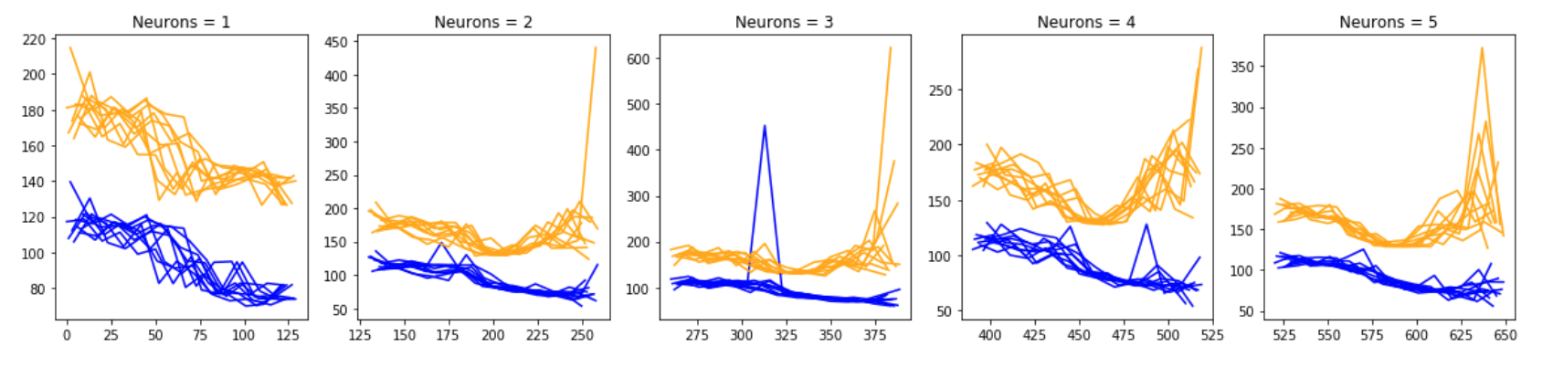
Hyperparameter Diagnostics
Diagnostic of 1 to 5 neurons
A line plot of the series of RMSE scores on the train(blue) and test(orange) for each set of neurons is created.
The number of neurons affects the learning capacity of the network. Generally, more neurons would be able to learn more structure from the problem at the cost of longer training time. More learning capacity also creates the problem of potentially overfitting the training data.

Slide 24
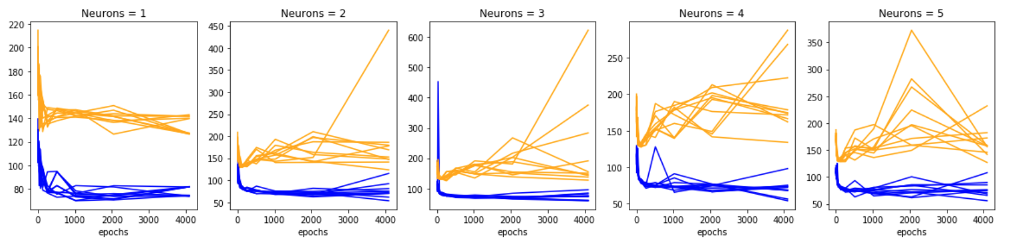
Hyperparameter Diagnostics
Diagnostic of 2^0 to 2^12 Epochs
A line plot of the series of RMSE scores on the train(blue) and test(orange) for each set of neurons is created.
The increasing trend is a sign of overfitting. This is when the model overfits the training dataset at the cost of worse performance on the test dataset. Severe overfitting shows sharp rise in test error.

Slide 25
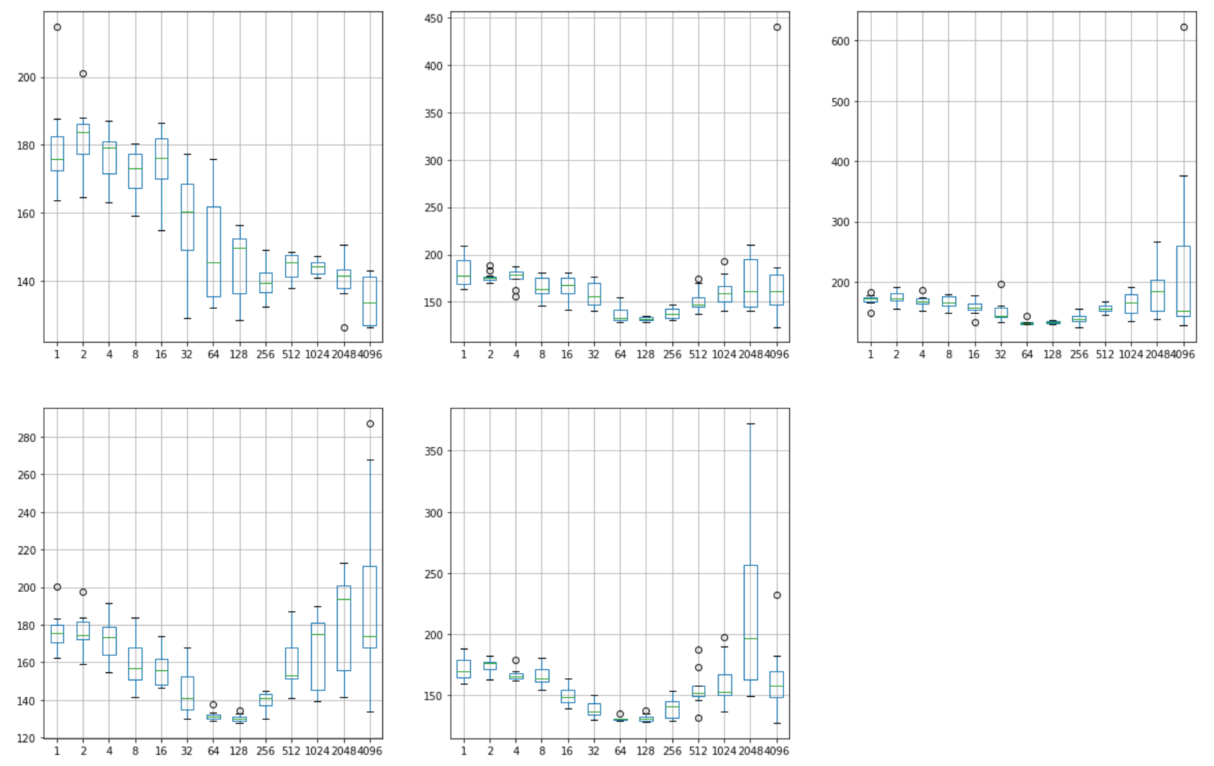
Hyperparameter Diagnostics
Box plot showing overall range of test RMSEs for each Epoch by Neurons(1 to 5).

Slide 26
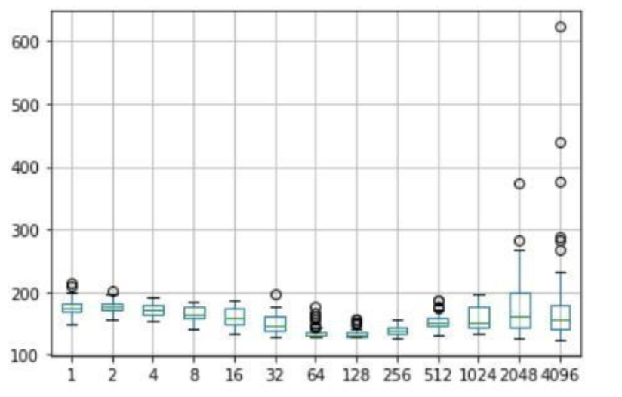
Hyperparameter Diagnostics
Box plot showing overall range of test RMSEs for each Epoch.
The plot shows that the best possible performance may be achieved with epochs between 128 and 512.
Tuning a neural network is a tradeoff of average performance and variability of that performance with an ideal result having low mean error with low variability meaning it is generally good and reproducible.

Slide 27
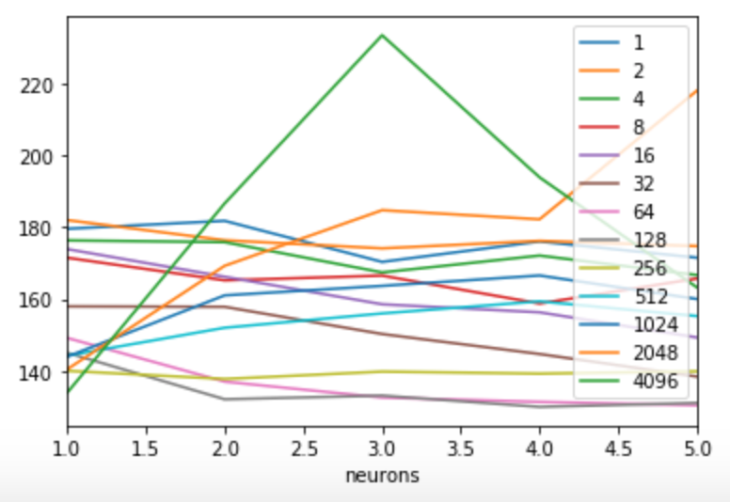
Hyperparameter Diagnostics
The plot shows the lowest RMSE range being achieved with 128 epochs.
The number of neurons affects the learning capacity of the network. Generally, more neurons would be able to learn more structure from the problem at the cost of longer training time. More learning capacity also creates the problem of potentially overfitting the training data.
4 Neurons gives the lowest RMSE compared to the others.

Slide 28
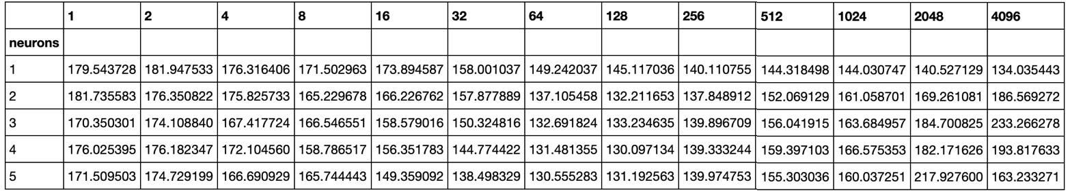
Hyperparameter Diagnostics Conclusion
From the mean performance alone, the results suggest a network configuration with 4 neurons as having the best performance over 128 epochs with a batch size of 1.
This configuration also shows the lowest RMSE and tightest variance.

Slide 29
Model Perspective
Limitation: Did not compare performance with other deep learning models
Approach: Other advanced LSTM versions and Deep Learning models could be implemented and tested for performance
Limitation: Did not consider other features that might influence the dependent variable.
Approach: Other features like Fuel Cost, number of Vehicles equipped with Alternative Fuels etc. could be included for Multivariate Time Series Analysis.

Slide 30
Business Perspective
Significant growth in use of Alternative Fuels in the recent past.
Provides sustainable growth by most importantly reducing Carbon dioxide emissions.
In the last decade, the average retail alternative fuel prices has been stable or slightly on a decline trend. https://afdc.energy.gov/fuels/prices.html.
I believe this trend to continue favoring Alternative Fuels due to following factors:
As dependency on petroleum fuels continue to decline.
Increase in Vehicle Owners with sustainability mindset.
Leap in technology to produce Alternative Fuels with lower production cost.

